Slide 1
Intro to Artificial Intelligence
Instructor: Zainab Yousuf

Slide 2
Content
Introduction to Artificial Intelligence
Advantages & Disadvantages of Artificial Intelligence
Domains of AI
Applications of AI

Slide 3
Artificial Intelligence
Intelligence can be considered as:
Problem Understanding
Problem solving skills
Ability to learn
Decision making abilities etc.
Intelligence is an intangible part of our brain which is a combination of Reasoning, learning, problem-solving perception, language understanding, etc.

Slide 4
Artificial Intelligence (Cont…)
Artificial Intelligence is composed of two words Artificial and Intelligence, where Artificial defines "man-made," and intelligence defines "thinking power", hence AI means "a man-made thinking power.“
or
“It is a branch of computer science by which we can create intelligent machines which can behave like a human, think like humans, and able to make decisions."

Slide 5
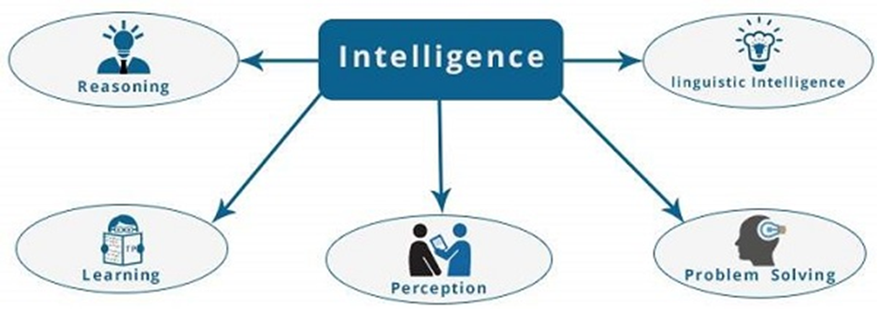
Artificial Intelligence (Cont…)
The intelligence is intangible. It is composed of −
Reasoning
Learning
Problem Solving
Perception
Linguistic Intelligence

Slide 6
Artificial Intelligence (Cont…)
Learning − It is the activity of gaining knowledge or skill by studying, practicing, being taught, or experiencing something. Learning enhances the awareness of the subjects of the study.
Problem Solving − It is the process in which one perceives and tries to arrive at a desired solution from a present situation by taking some path, which is blocked by known or unknown hurdles.
Problem solving also includes decision making, which is the process of selecting the best suitable alternative out of multiple alternatives to reach the desired goal are available.
Perception − It is the process of acquiring, interpreting, selecting, and organizing sensory information.
Perception presumes sensing. In humans, perception is aided by sensory organs. In the domain of AI, perception mechanism puts the data acquired by the sensors together in a meaningful manner.
Linguistic Intelligence − It is one’s ability to use, comprehend, speak, and write the verbal and written language. It is important in interpersonal communication.

Slide 7
Artificial Intelligence (Cont…)
To achieve the above factors for a machine or software Artificial Intelligence requires the following discipline:
Mathematics
Biology
Psychology
Sociology
Computer Science
Neurons Study
Statistics

Slide 8
Why Artificial Intelligence?
Following are some main reasons to learn about AI:
With the help of AI, you can create such software or devices which can solve real-world problems very easily and with accuracy such as health issues, marketing, traffic issues, etc.
With the help of AI, you can create your personal virtual Assistant, such as Cortana, Google Assistant, Siri, etc.
With the help of AI, you can build such Robots which can work in an environment where survival of humans can be at risk.
AI opens a path for other new technologies, new devices, and new Opportunities.

Slide 9
Advantages of Artificial Intelligence
High Accuracy with less errors: AI machines or systems are prone to less errors and high accuracy as it takes decisions as per pre-experience or information.
High-Speed: AI systems can be of very high-speed and fast-decision making
High reliability: AI machines are highly reliable and can perform the same action multiple times with high accuracy.
Useful for risky areas: AI machines can be helpful in situations such as defusing a bomb, exploring the ocean floor, where to employ a human can be risky.
Digital Assistant: AI can be very useful to provide digital assistant to the users such as AI technology is currently used by various E-commerce websites to show the products as per customer requirement.
Useful as a public utility: AI can be very useful for public utilities such as a self-driving car which can make our journey safer and hassle-free, facial recognition for security purpose, Natural language processing to communicate with the human in human-language, etc.

Slide 10
Disadvantages of Artificial Intelligence
High Cost: The hardware and software requirement of AI is very costly as it requires lots of maintenance to meet current world requirements.
No feelings and emotions: AI machines can be an outstanding performer, but still it does not have the feeling so it cannot make any kind of emotional attachment with human, and may sometime be harmful for users if the proper care is not taken.
Increase dependency on machines: With the increment of technology, people are getting more dependent on devices and hence they are losing their mental capabilities.
No Original Creativity: As humans are so creative and can imagine some new ideas but still AI machines cannot beat this power of human intelligence and cannot be creative and imaginative

Slide 11
Domains of AI
Perception (Computer vision, NLP, Touch sensation)
Robotics
Planning
Expert System
Theorem Proving
Gaming
Drones
Machine Learning
Neural Networks
Deep Learning
Data Sciences

Slide 12
ARTIFICIAL INTELLIGENCE EXAMPLES
Manufacturing robots
Smart assistants
Proactive healthcare management
Disease mapping
Automated financial investing
Virtual travel booking agent
Social media monitoring
Inter-team chat tool
Conversational marketing bot
Natural Language Processing (NLP) tools

Slide 13
Thank You

